Slide 1
ASP NET MVC 3
February 21st, 2011
Notes:
Introduction of team

Slide 2

Developing Web Applications

Slide 3


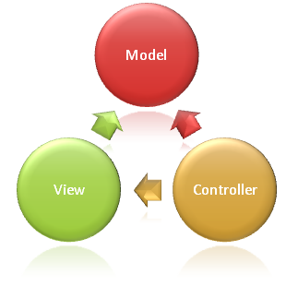


Rethinking the Web Platform

Slide 4
The need for MVC
Development for the web platform
Separation of Concerns
Testability
Portability
Extensibility / Control

Slide 5
Limitations of MVC
Essentially Featureless
Leverages many advanced OO/Platform concepts
Inverted complexity curve
Notes:
You should NOT use ASP.NET MVC if. . . You are not very comfortable with polymorphism
ASP.NET MVC makes use of interfaces, abstract classes, virtual methods and some psuedo-AOP. If you are not well-versed with these object-oriented concepts, then the framework might not be very friendly for you. While WebForms uses the template method to give the developer some well-defined places to put code, the MVC framework specifies an array of extension points that leverage the power of object-oriented programming to add on and extend the framework.

Slide 6
The future of MVC on the Microsoft stack
Faster application development support
Microsoft value differentiators
Maturity of tools and framework

Slide 7
What’s new in MVC 3
Razor view engine
NuGet
Validation
Unobtrusive JavaScript

Slide 8

Installing MVC 3
Installing MVC 3
Installing/Updating NuGet
Notes:
9831332

Slide 9

Razor View Engine
View engines in ASP .NET
Comparing view engines
Webforms
Spark
NHaml
Notes:
15442382

Slide 10

NuGet
What is it
Managing libraries in the legacy style
Target platforms
Relationship with MVC
Integrating packages with NuGet
Notes:
15442382

Slide 11

MVC 3 Enhanced Validation
Self-validating models
Client validation provider
Improved annotations
Remote validations
Notes:
15442382

Slide 12
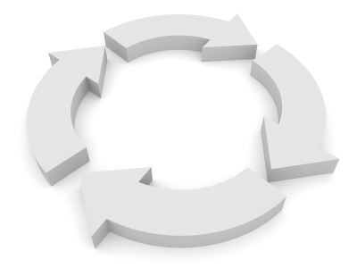
New Action Results
HttpNotFoundResult (404)
HttpStatusCodeResult (xxx)
HttpRedirectResult (301)
Notes:
15442382

Slide 13

John Dages twitter: @jdages source: github.com/jdages/mvc-3-presentation

